Slide 1







Low-Frequency Observations of the Radio Sky from Marion Island
Tankiso Moso for the ALBATROS Collaboration
University of KwaZulu Natal, Durban, South Africa

Slide 2
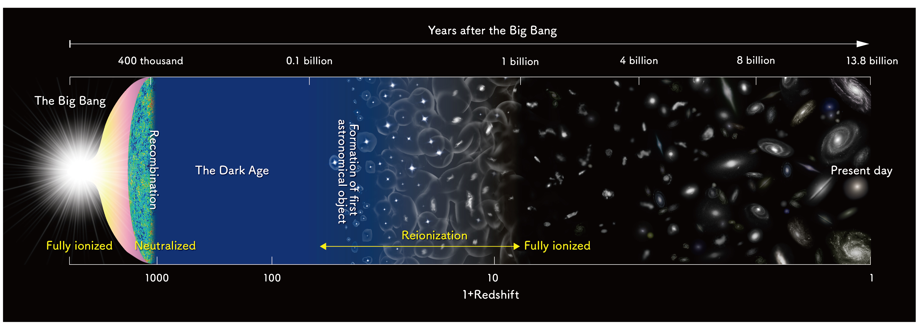
History of the Universe
Image Credit: NAOJ/ NOAO
The final goal is to lay groundwork for exploring the dark ages.
For now we’re taking steps towards mapping the foregrounds and the frequencies of interest are from ~1.3 MHz to ~46 MHz (z~1100 – z ~ 30).

Slide 3
The State of Art at Low Frequencies
Experiment | Frequency | Resolution | Year
DRAO Penticton | ≈10 MHz | ≈2 deg | 1967
Grote Reber | ≈2.1 MHz | ≈5 deg | 1968
RAE-B Satellite | ≈4.7 MHz | ≈10 deg | 1978
DRAO | ≈22 MHz | ≈1.1 – 1.7 deg | 1999
LWA | ≈36 MHz | ≈15 arcmin | 2017

Slide 4
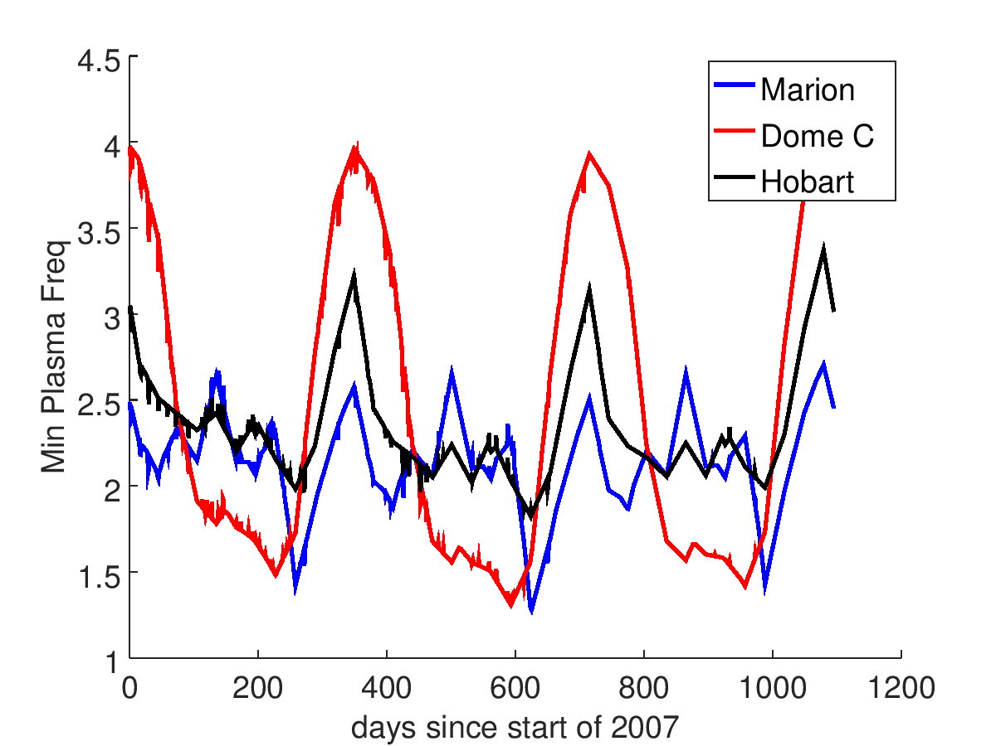
How low can we go on Marion
The International Reference Ionosphere model predictions illustrating the ionospheric plasma cutoff frequency at ∼ 1.5 MHz during last solar minima.

Slide 5
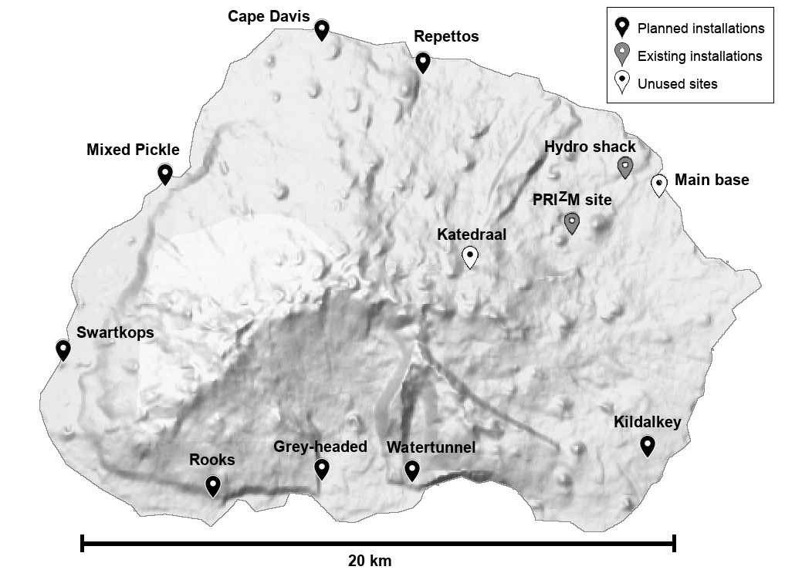
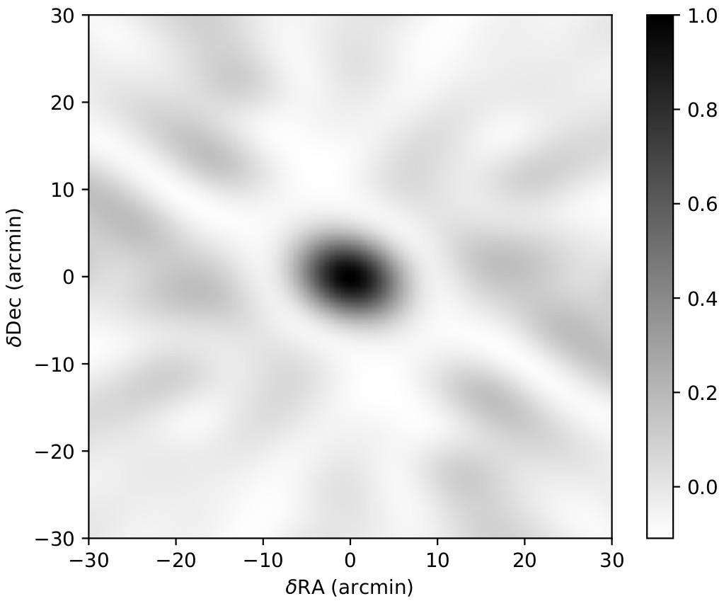
Autonomous Stations
Will be the final project which will consist of autonomous antenna stations separated by baselines of ≈20 km.
Marion Island huts which are potential stations for the ALBATROS have a ring-like pattern which is appropriate for imaging and produces an angular resolution of ~ 7’ for a synthesized beam at 5 MHz
Notes:
The final project (ALBATROS) is aimed at consisting of autonomous antenna stations that will map the low frequency sky. These stations will be separated by baselines of ≈20 km. This ring-like pattern is advantageous for imaging. It produces a full width at half maximum of 8 arcminutes from a synthesized beam at 5 MHz.

Slide 6
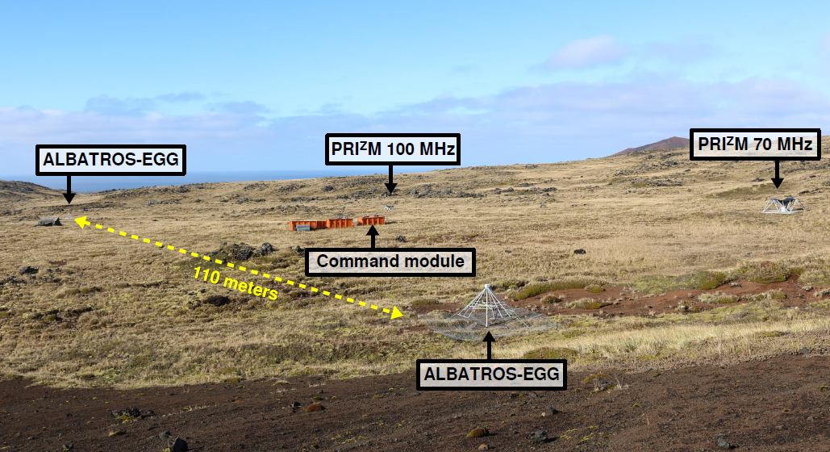
Array of Long Baseline Antennas for Taking Radio Observations from the Sub-Antarctic (ALBATROS) - Pathfinder
Marion Island
Notes:
ALBATROS-EGG is a recently deployed two element interferometeric array which has an operating frequency range between 1.2 MHz- 81 MHz which corresponds to a redshift z≈1190-17. These interferometric elements are separated by a baseline of 110 m. It was deployed in Marion Island in April 2018. It was inspired by the Long Wavelength Array (LWA) experiment in New Mexico which has an operating frequency range of 10-88 MHz which corresponds to z≈a142-15. This two-element interferometric array also uses the LWA hardware. Both experiment’s antennas are dually polarized and they both map the dark ages and the cosmic dawn. LWA experiment observes the Northern and Western sky and the ALBATROS - EGG probes the Southern sky. Maps the dark ages (from recombination to the formation of the first astronomical objects) and cosmic dawn (first stars life, death and impact in the Universe).

Slide 7
Pathfinder Block Diagram

Slide 8
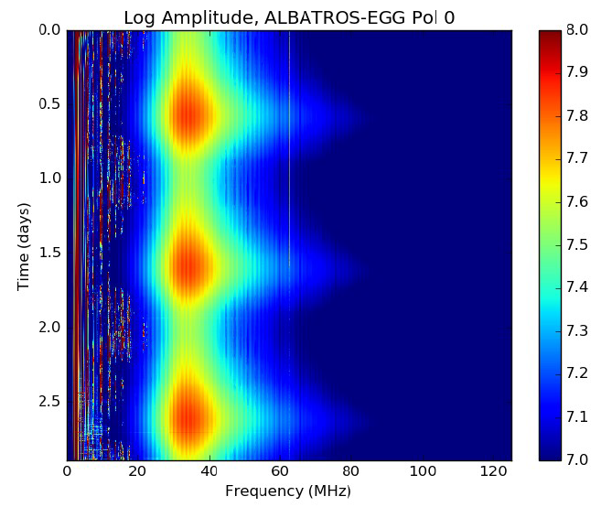
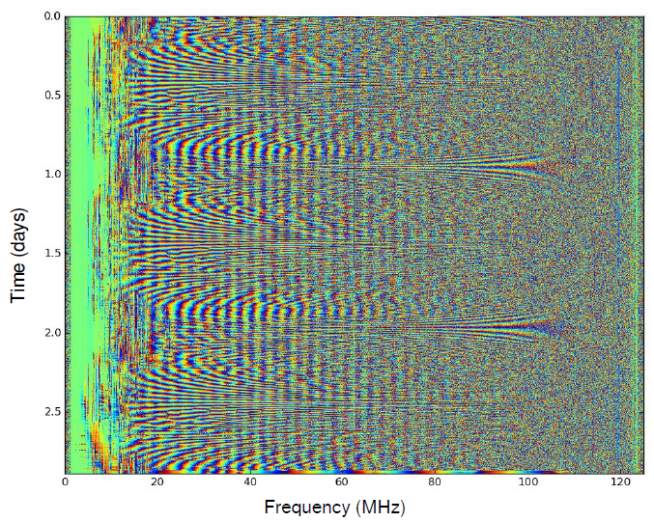
Pathfinder Results
Auto spectra
Cross Correlation
Waterfall runs for 3 days
Galaxy rising clearly visible.
Ripples in frequency because of uncalibrated data
Fringes clearly visible
Repeatable structures at ≈10 MHz without data processing or cuts

Slide 9
Autonomous Stations
Current firmware capable of 1-, 2-, 4-bit baseband.
Notes:
The final project (ALBATROS) is aimed at consisting of autonomous antenna stations that will map the low frequency sky. These stations will be separated by baselines of ≈20 km. This ring-like pattern is advantageous for imaging. It produces a full width at half maximum of 8 arcminutes from a synthesized beam at 5 MHz.

Slide 10
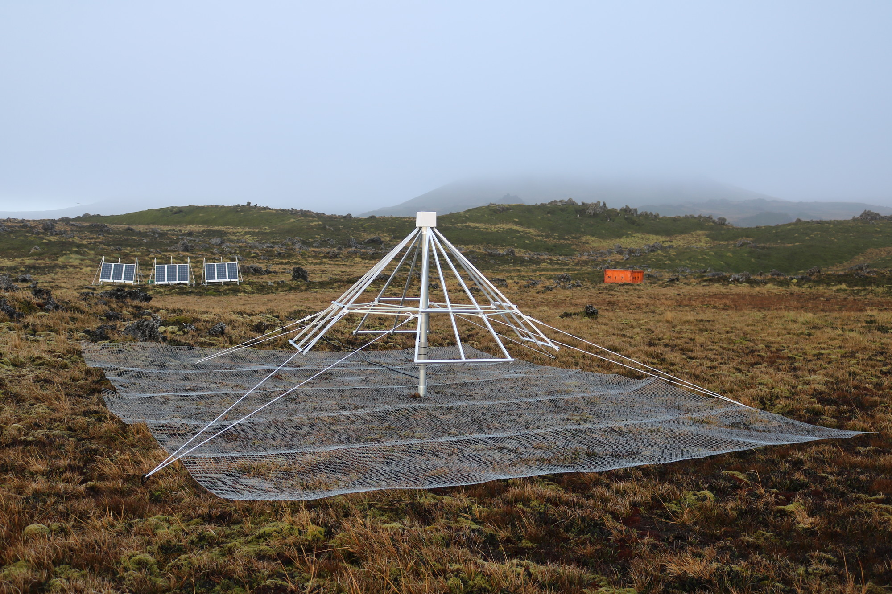
2019 Deployment of the First Autonomous Station

Slide 11
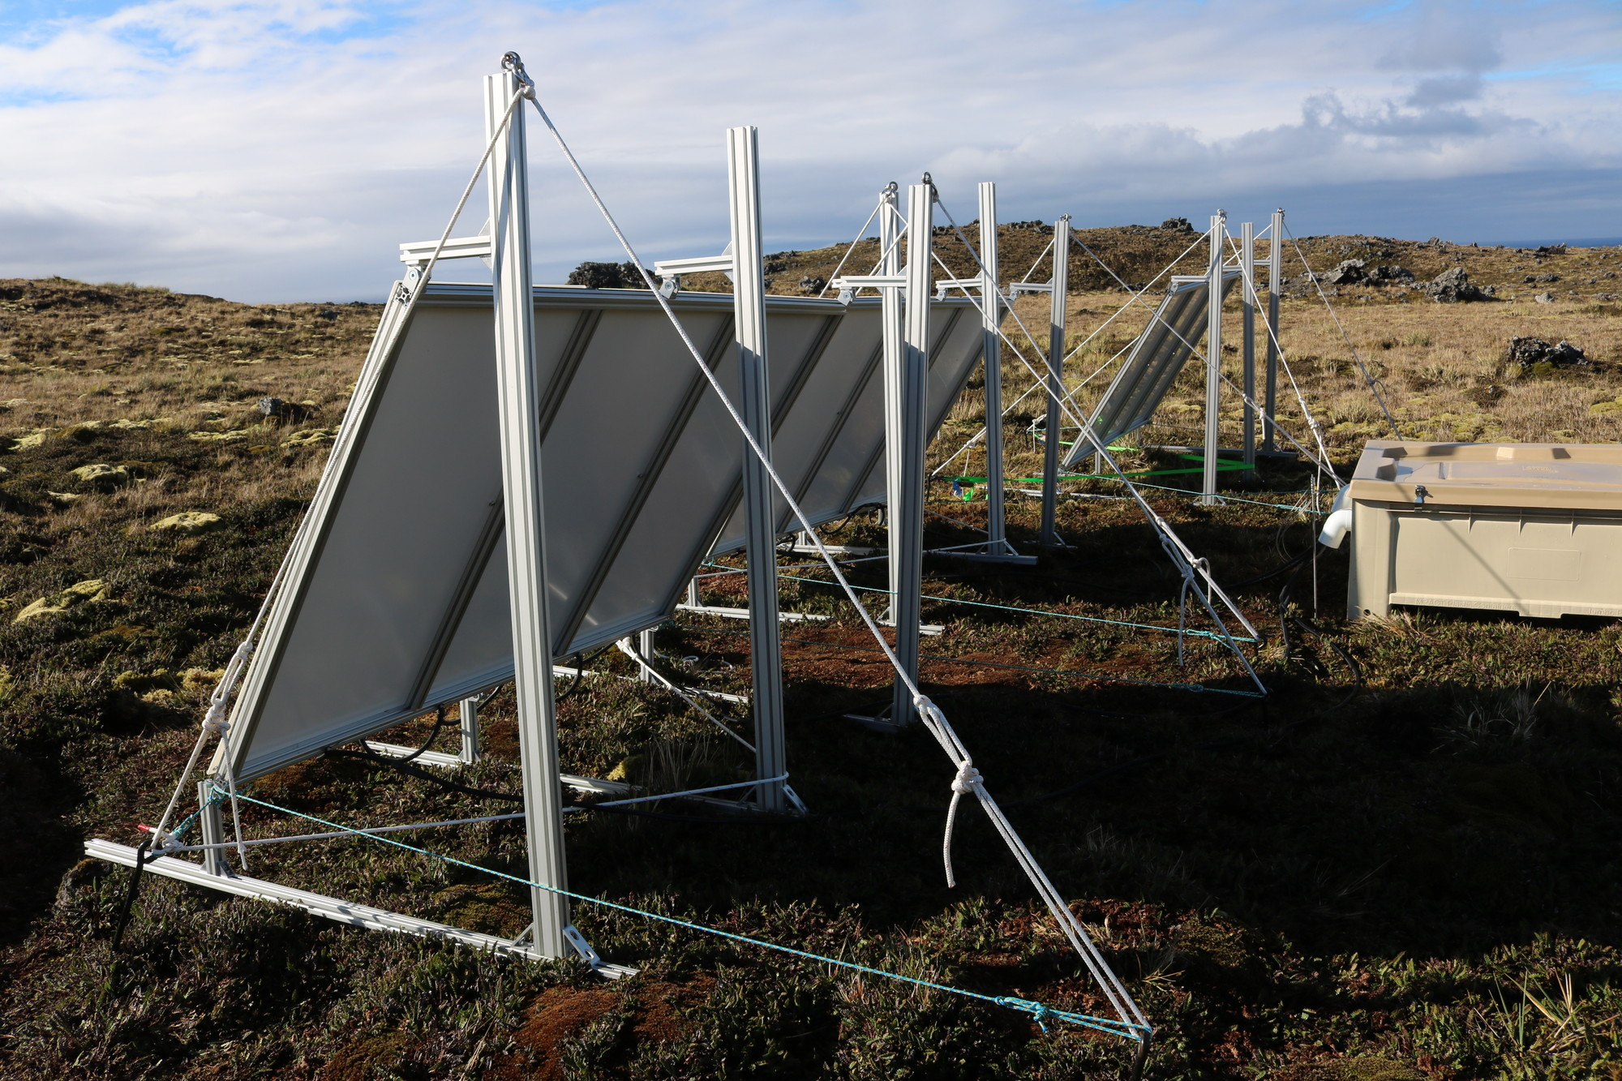

Slide 12
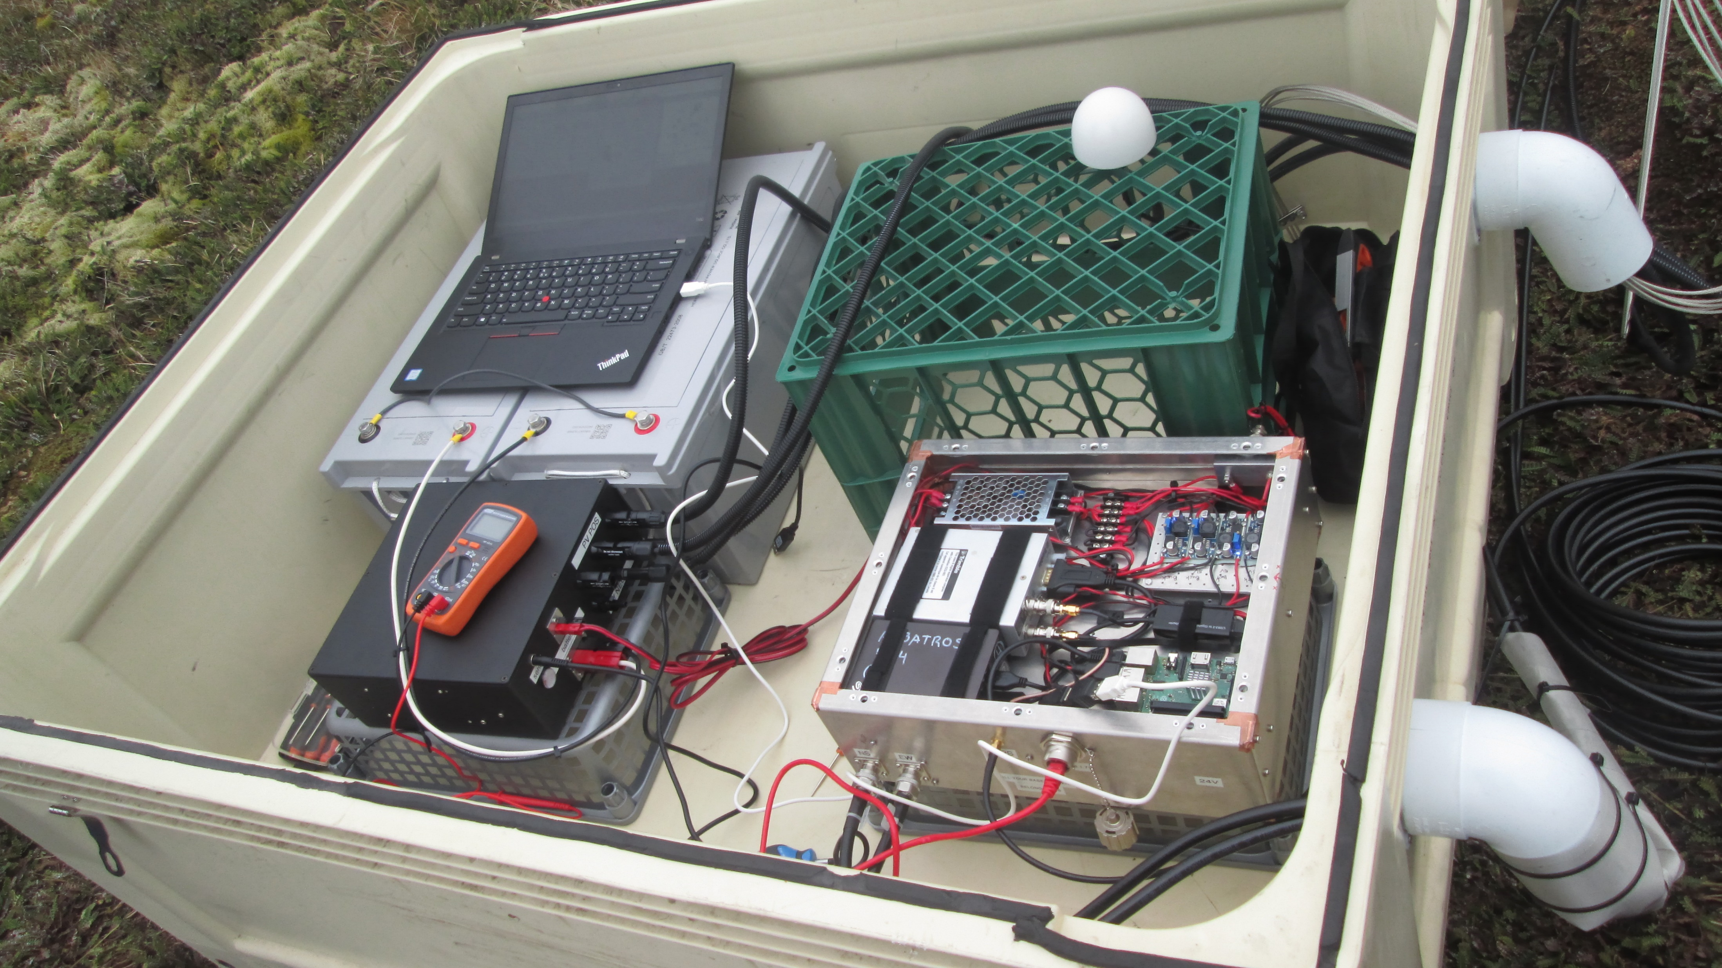
GPS Antenna
RF Signal, DAQ and Data Storage Enclosure
Solar Power Control Box

Slide 13
ALBATROS Baseband Recording from MARS
Audio Credit: Simon Tartakovsky
Random shortwave station broadcasting around 13 MHz
Audio was recovered using 4-bit baseband
The higher the number of bits, the higher the signal fidelity.

Slide 14
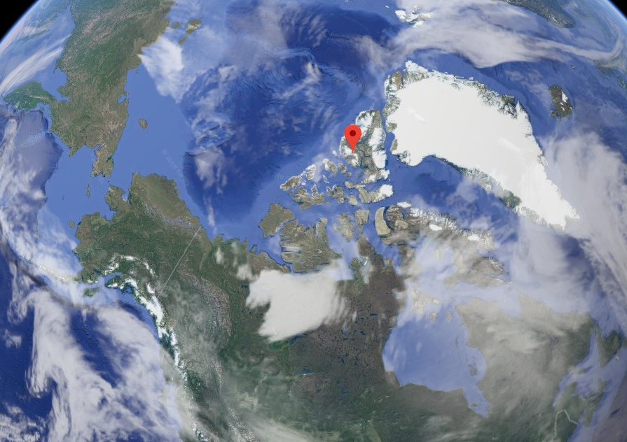

Conclusion and Future Plans
Next Marion deployment scheduled for April 2021 (2020 voyage cancelled because of COVID-19).
Tentative plan of installing two new autonomous stations in 2021 and we will gradually install the rest.
ALBATROS autonomous stations installation at the McGill Arctic Research Station (MARS)
Analysis of our available data
ALBATROS instrument paper in progress
MARS
79°26′N 90°46′W
Tankiso Moso
Tankiso.Moso@gmail.com

